Slide 1
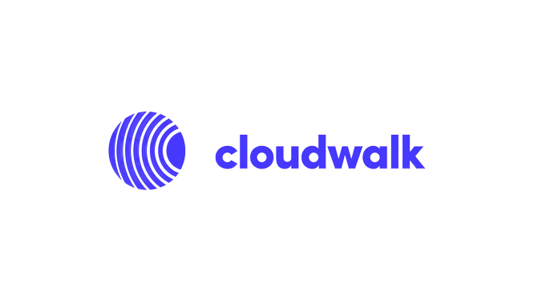
Risk Analyst.
Case Presentation.

Slide 2
Agenda
Understanding the Industry.
01
02
Solving the problem.
04
Conclusions.
03
Getting Hands Dirty.

Slide 3

Understanding the Industry.
01

Slide 4
Money Flow.
Explaning the money flow, the information flow and the role of the main players in the payment industry.

Slide 5

Brand
Customer
Card
Issuer Bank
Merchant
Acquirer

Slide 6


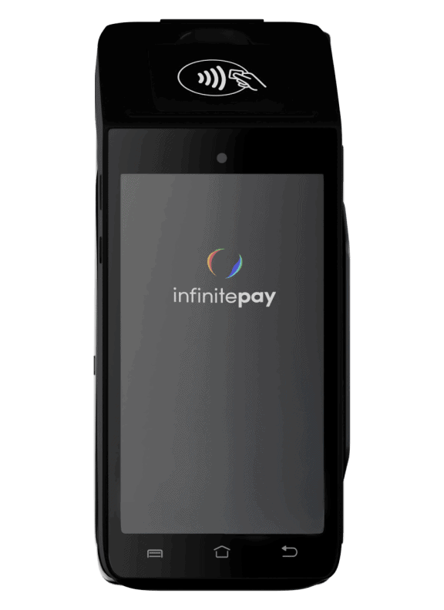
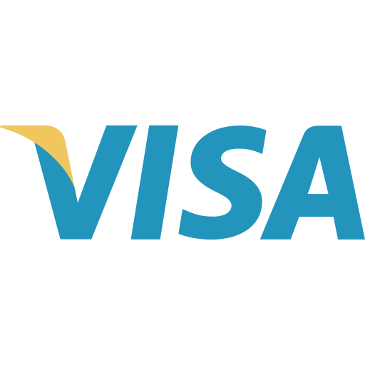

Roles
Customer
Merchant
Acquirer
Brand
Issuer Bank
Our brave customer, who supports business, the one who buys something with a card.
Merchant are basically someone providing a service.
Responsible for processing payments, meaning that it processes credit card payments on behalf of a merchant, such as InfinitePay, Cielo, Rede, GetNet.
Card brands are company responsible for defining the business rules for purchases, defining standards for the whole industry.
The one who isuues the card for the costumer, who approves or deny a purchase, depending on available credit or available monetary resources

Slide 7
There’s not only Acquirer…
Explaning the difference between acquirer, sub-acquierer and payment gateway

Slide 8
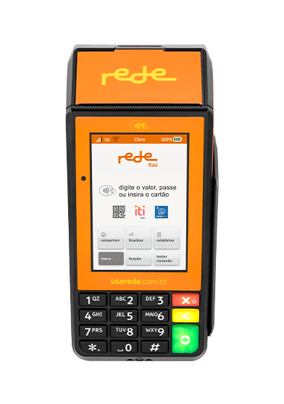
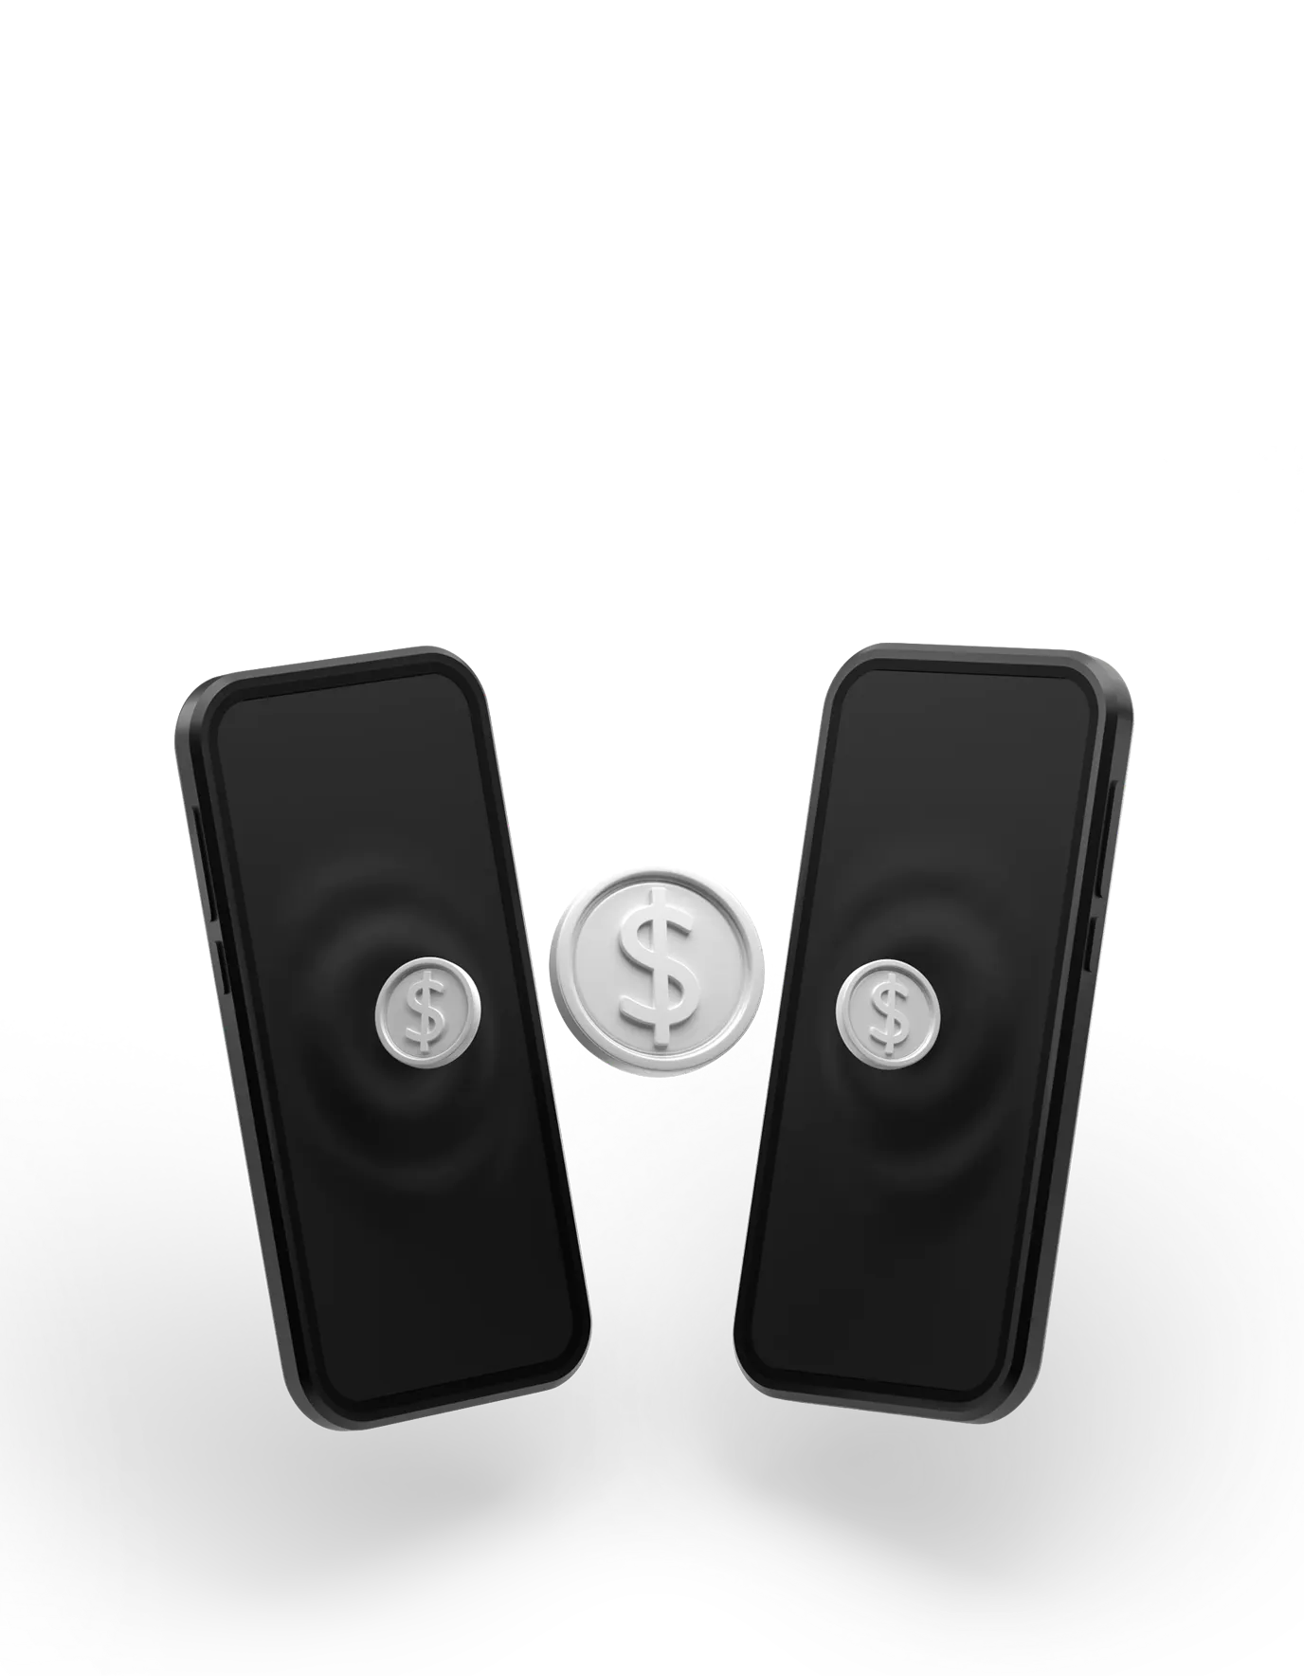


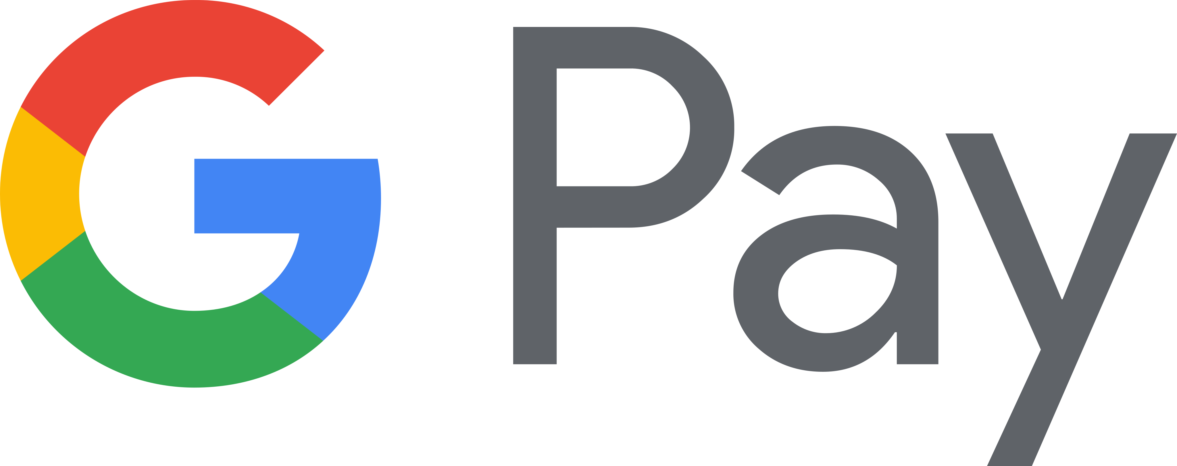

Acquirer, Sub-Acquirer and Gateway
Acquirers
Sub-Acquirers
Gateway
Acquirers are responsible for providing the communication between merchants, Brands and issuer Bank.
Sub-Acquirers are responsible for Intermedium the payment between the merchants and the acquirers, who’s responsible for contacting the issuer bank. Gateway are already integrated.
Gateway transport information between acquires, merchants and issuer bank, grant the costumer data security, during an online purchase flow, totally customized. It can be integrated with multiple acquires and anti-fraud systems.

Slide 9
Payment Gateway Flow.
Customer
Merchant Store
Payment gateway
Payment Processor
Issuer Bank
Merchant Account

Slide 10
Chargebacks
What are chargebacks, how they differ from cancellation and what is their connection with fraud in the acquiring world.

Slide 11
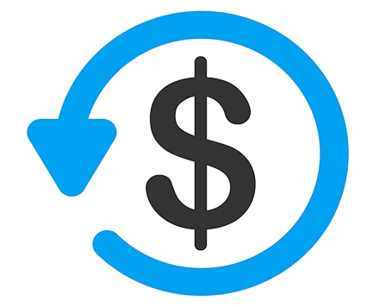
Chargeback?
What ’s that?
Chargeback is the reversal of the value to the customer, whether due to a company or operator error, or because it is an improper purchase and not recognized by the buyer
Cancellation or Chargeback?
The main difference is that while chargeback is carried out by the customer, the cancellation comes from the merchant who made the sale
Chargeback Frauds
Scammers can take advantages of this loophole. Without proof, the financial institution have to return the fund, causing highly financial lost.

Slide 12
Solving the Problem
02

Slide 13
Real World Problem.
Leading with a real world problem, where a client contacts the company through e-mail asking for a chargeback status.

Slide 14

Problem.
A client sends you an email asking for a chargeback status. You check the system, and see that we have received his defense documents and sent them to the issuer, but the issuer has denied it. They claim that the cardholder continued to affirm that she did not receive the product, and our documents were not sufficient to prove otherwise.
You respond to our client informing that the issuer denied the defense, and the next day he emails you back, extremely angry and disappointed, claiming the product was delivered and that this chargeback is not right.
Considering that the chargeback reason is “Product/Service not provided”, what would you do in this situation?

Slide 15

Case Analysis
Some hypotheses of fraud involved are:
Analyzing the presented scenario, we can identify the possibile actors involved in the chargeback case
Self-fraud
Effective fraud
Friendly fraud
mislay
Client (Service Provider)
Acquirer (CloudWalk)
Issuer (Financial Institution)
Client (Cardholder/who requested the product / service)
As the documentation presented is not sufficient to identify fraud or mislay, it will be necessary to contact supplier for more evidence of the delivery of the product.

Slide 16

Case Solution.
Dear Client, we apologize for the inconvinient, but we will not be able to proceed with your chargeback request, due to lack of evidences. I suggest providing appropriate documentations, related to product delivery, status and invoice. After sending concrete proofs, we will follow up with your chargeback request and have a better conclusion for both parts involved.
Best regards.

Slide 17
Getting Hands Dirty.
03

Slide 18


Data Analysis I
Analyze the data provided and present conclusions. What suspicios behaviors are presented? What’s the conclusion?

Slide 19
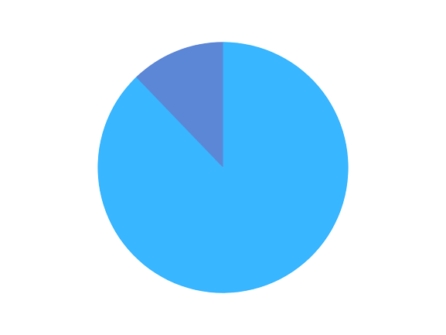
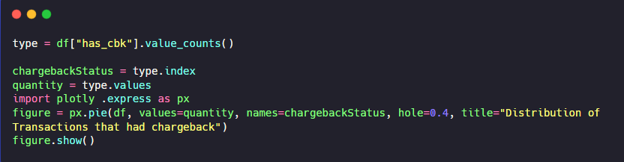
ChargeBack
The first analyse made, which got my attention was the chargeback cases, which was 12.2% over 3199 transactions made. Excessive chargebacks can cause financial damage, which related me to think that this could be a potential problem that should be investigated.
12.2%
87.8%

Slide 20
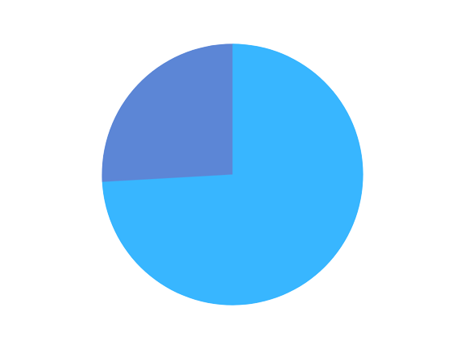
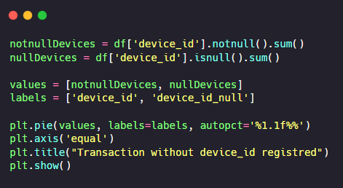
Client Device
25.9% over 3199 transactions were made without registering a client_device_id , which let me thinking this could be a possible system error, or all of those transactions were made in person, without using a properly device, which gets harder to track suspicious client behaviour.
25.9%
74.1%

Slide 21
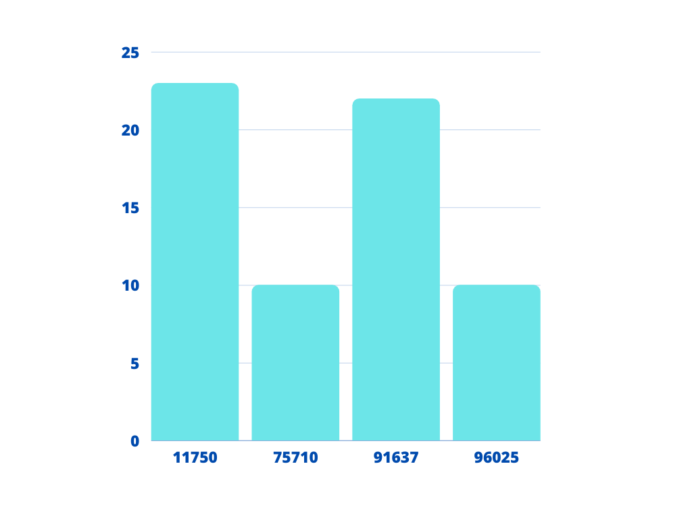
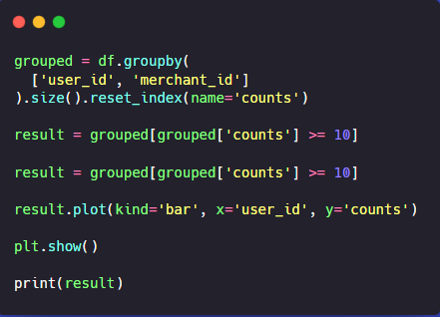
Transactions Analysis
Checking the user_id, (our customers) who purchased more than 10 times at the same merchant. The idea is to check, because frauds may happen frequently at the same merchant. After seeing that, we can assume that we had 4 customers with suspicious behavior, some reaching over 20 transactions at the same merchant in a short period of time.
transactions
User_id

Slide 22
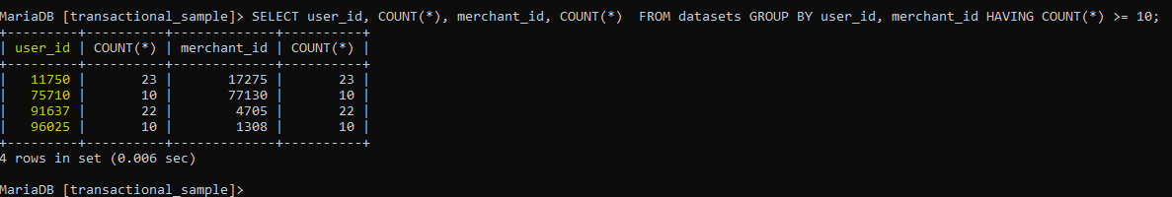
Transactions Analysis
After creating a local database instance, importing all transactional_sample present, I had to query this data, to see exactly the merchant_id corresponded to the user_id, exactly the merchants which our customers had purchased.

Slide 23
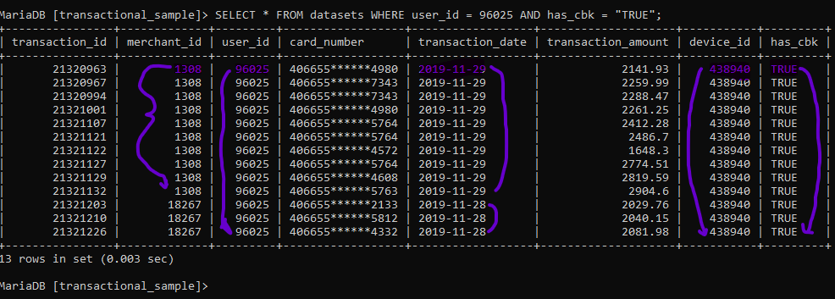
Transactions [Different Card Number]
After carefully analysing, I select a specific user_id to visualize the transactions, and we can figure out that, this customer had over 10 transactions at the same merchant, besides, bought it with different cards, an amount more than average in the dataset, in addition to that, all the transactions were chargebacks.

Slide 24
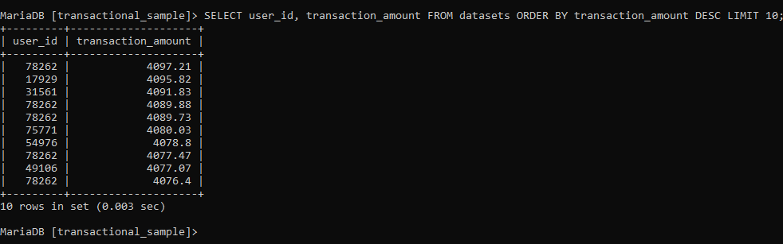
Transactions [Amount]
Getting historical highest transactions to check if there’s similar purchases, mostly close to the same value as before, made by the same customer, who can perform in fraudulent behavior

Slide 25
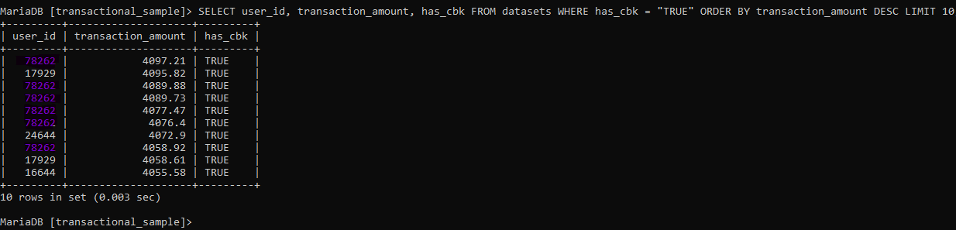
Transactions [Amount]
Considering the highest transactions, who had chargeback, we can notice that there’s an user_id who purchased over the average transactions, frequently in a short period of time.

Slide 26
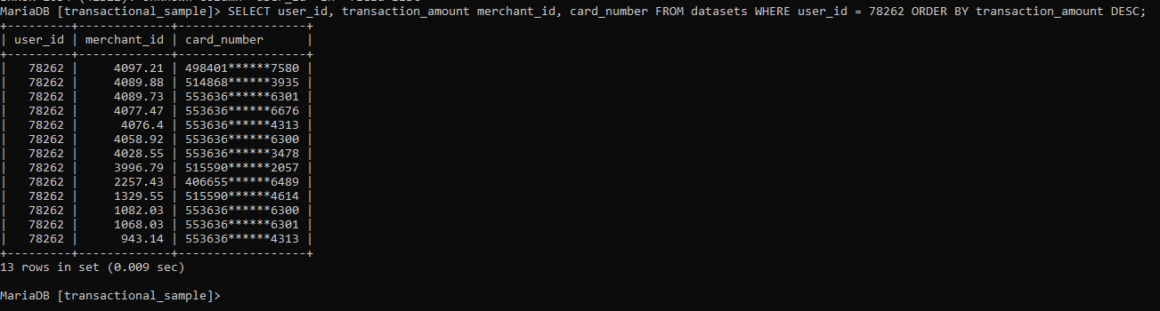
Transactions [Different Card Number]
The same customer, who had the highest historical values, also had transactions with diferente card numbers, not only in the same Merchant but others.

Slide 27


Full Fraud Analysis Case [version 1.0.0]
Python:
https://github.com/Deividev365/payment_fraud_analysis/blob/main/fraud_analysis.ipynb
SQL Queries:
https://github.com/Deividev365/payment_fraud_analysis/blob/main/queries.sql

Slide 28
Data Analysis II
In addition to the spreadsheet data, what other data would you consider to find patterns of possible fraudulent behavior?

Slide 29
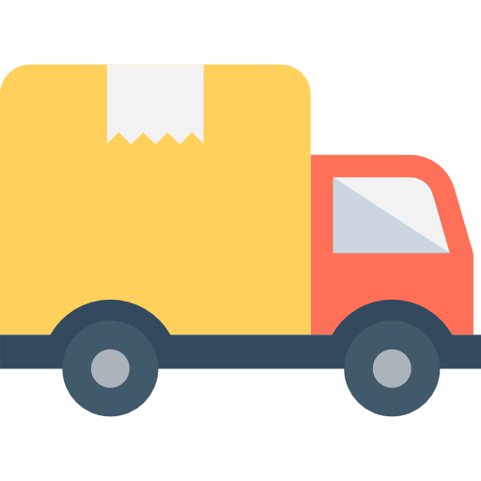

Possibilities Beyond
IP Adress: Containing transaction’s Location
Shipping information: If the transaction involves physical goods, the shipping information (e.g., address, name) could be compared against the billing information to identify inconsistencies.
Email or phone number: Verifying the email or phone number associated with the transaction could help identify fake or stolen identities.

Slide 30
Data Analysis III
Considering the conclusions, what are the others suggestions in order to prevent frauds or chargebacks?

Slide 31
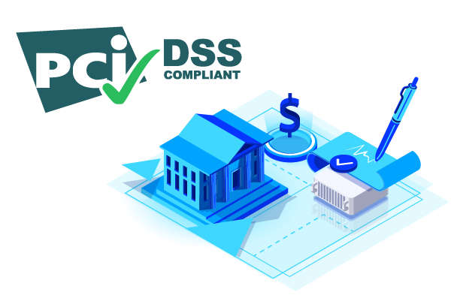


Fraud Prevention
Using AI fraud detection Softwares to prevent fraudelent actions, including chargebacks operation;
Being accurately to PCI DSS compliance rules to stay up to the market secure environment;
Providing excellent customer service. It can reduce chargebacks by addressing customer concerns;

Slide 32
Conclusions.
04

Slide 33
—Carl Sagan
“Imagination will often carry us to worlds that never were. But without it we go nowhere”

Slide 34
Referências
Bonfim, C.A. Modelo Preditivo para detecção de fraudes. Medium, 01/02/2021. Disponível em: https://carlos-bonfim.medium.com/modelo-preditivo-para-detec%C3%A7%C3%A3o-de-fraudes-a3ec4ce54497. Acessado em: 05/02/2023.
BTC. Qual é a diferença entre Adquirente, Subadquirente e Gateway?. YouTube,19/03/2021. Disponível em: https://youtu.be/68I2oktrZoU. Acessado em: 05/02/2023.
Comalytics. E-commerce: How payment gateways work. Comalytics, 2020. Disponível em: https://www.comalytics.com/e-commerce-payment-gateways/. Acessado em: 05/02/2023.
Merenna,I. O que é Chargeback?. Raio-x, 04/09/2020. Disponível em: https://raiox.com.br/o-que-e-chargeback/. Acessado em: 05/02/2023.
Rosa, L. Como funciona uma transação de cartão de crédito. Medium, 03/08/2020. Disponível em: https://lucascmrosa.medium.com/sistemas-de-pagamentos-i-cart%C3%B5es-53ece499f9e3. Acessado em: 05/02/2023.

